Slide 1



Analysis of the effect of students’ clothing and gender on student-teacher interaction

Slide 2
Content
Introduction to the experiment
Data description
Analysis approach
Results
Summary of findings
Recommendations
Limitations and further improvements

Slide 3
Part 1:
Introduction
2. Data description
3. Analysis Approach
4. Results

Slide 4







The Experiment
Objective: examine whether the interaction between student and teacher differed according to the gender and the type of clothing worn by a student
Experiment: observe several classes taught by one teacher and count the interactions between student and teacher. Each interaction was classified as either ‘Negative’ or ‘Positive’

Slide 5
Part 2:
Data description
3. Analysis Approach
4. Results
5. Summary of findings

Slide 6
Dataset
462 observations
Characteristics of the observation:
Clothing type:
Other: Unusual clothing
Std: Standar gender-specific clothing
Unisex: Clothing for men and women
Gender:
Female
Male
Count: Number of interactions
Interaction Type:
NegInt: Negative interaction
Posint: Positive interaction

Slide 7
Part 3:
Analysis Approach
4. Results
5. Summary of findings
6. Recommendations

Slide 8
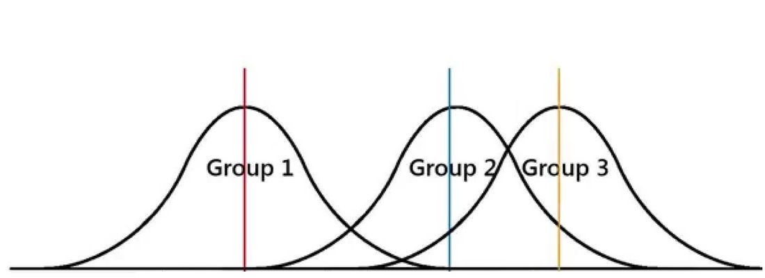
Model -ANOVA-
ANOVA is used to verify if the difference between the means of a quantity is significant. In other words, checks if a difference is caused by chance or not.
For this experiment, ANOVA was used to verify if there is a difference between the average number of interactions between students and teacher, based on the clothing type, gender, and type of interaction.

Slide 9
Part 4:
Results
5. Summary of findings
6. Recommendations
7. Limitations and further improvements

Slide 10
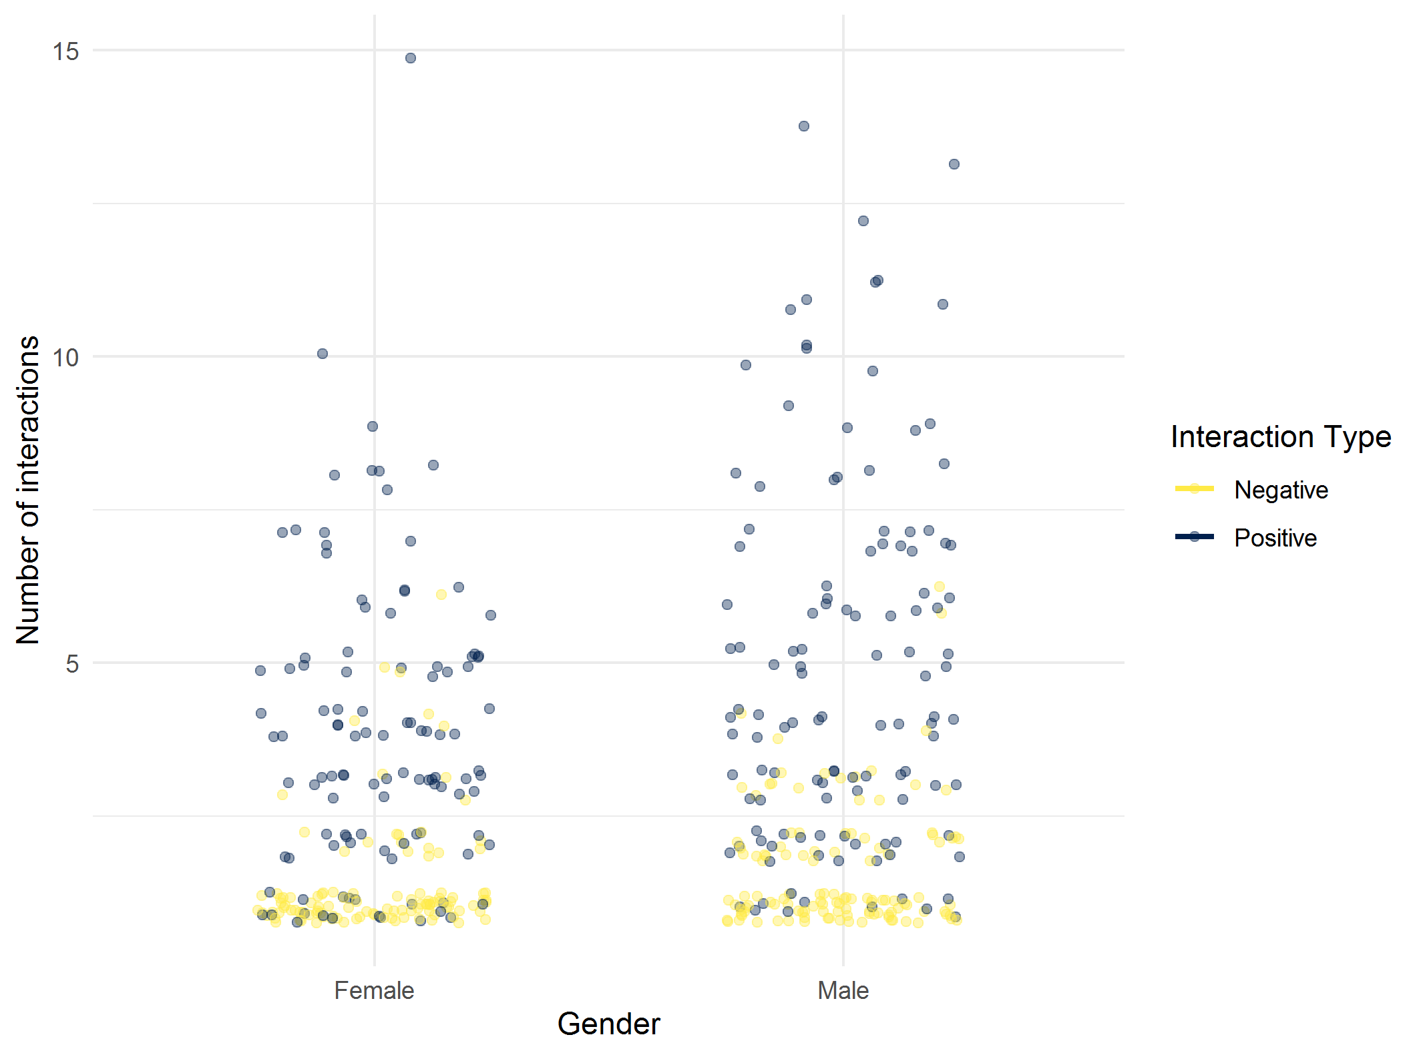
Gender
Number and type of interactions per gender
Gender | Number | Percentage
Female | 222 | 48.1%
Male | 240 | 51.9%
hypothesis: a male student, on average, has more interactions than a female student.

Slide 11
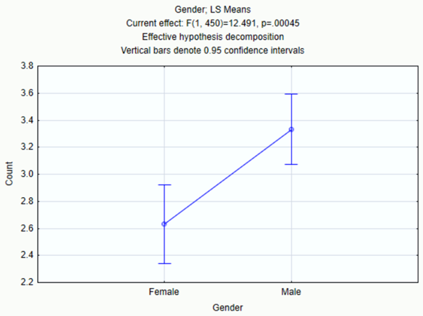

Gender
ANOVA
There is a difference between the average number of interactions of the teacher with women and men.
In average, a woman has 2.59 interactions, while a man has 3.27
Significant Difference

Slide 12
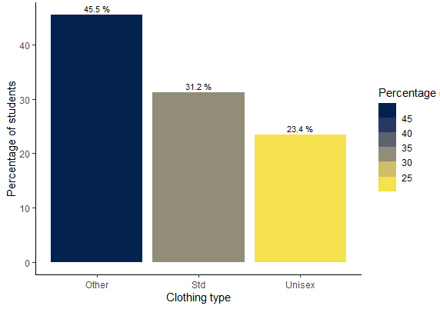
Clothing Type
Distribution of clothing type amongst all students
hypothesis: the type of clothing has an impact on the number of interactions between the student and the teacher.

Slide 13
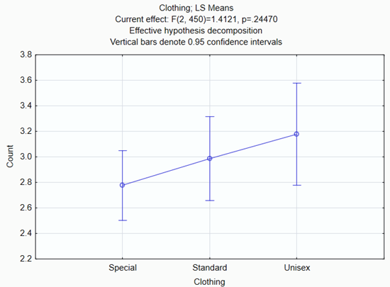
Clothing Type
ANOVA
It seems that there is a difference between the average number of interactions depending on the clothing. But in the model this difference is not significative.
NO Significant Difference

Slide 14
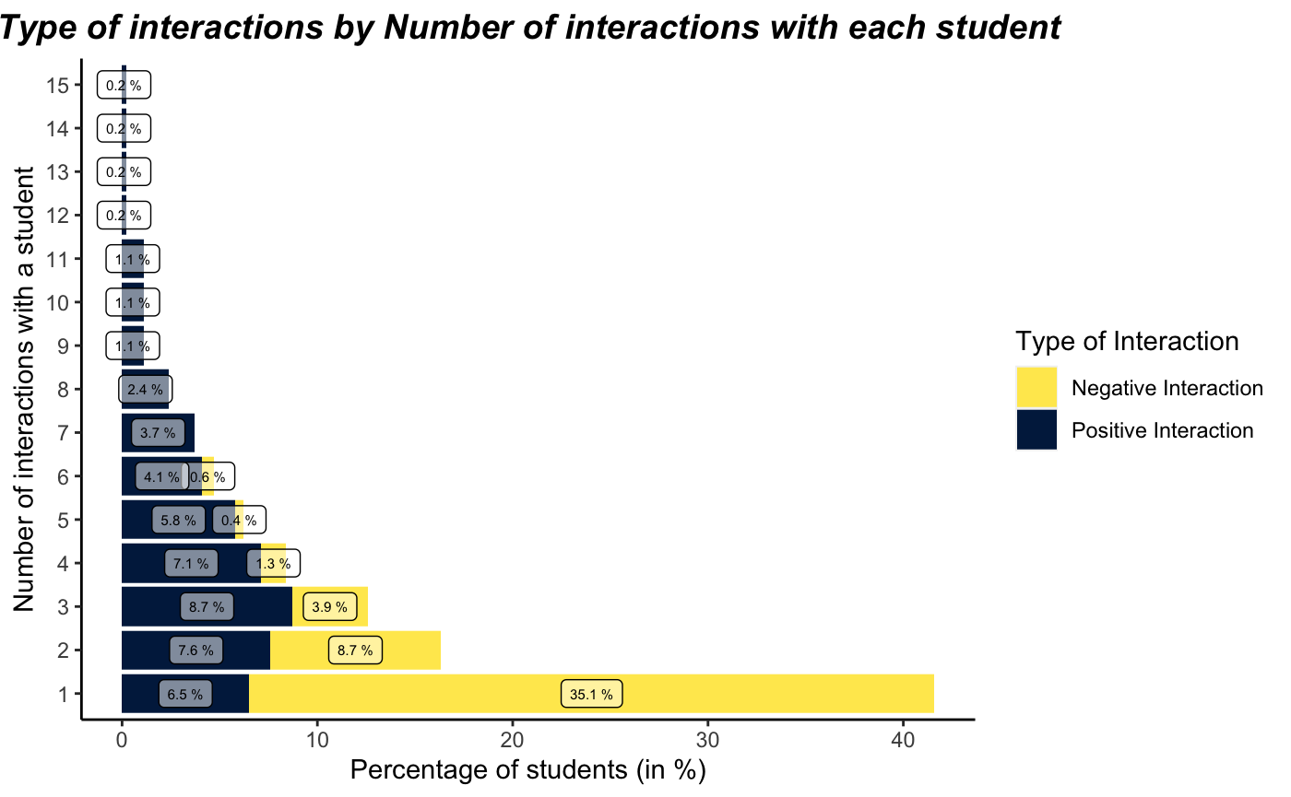
Type of interactions by proportion
Relationship between the type and number of interactions
When a student receive just one interaction, it tends to be negative. If a student has more than 3 interactions, almost all of them will be positive.

Slide 15
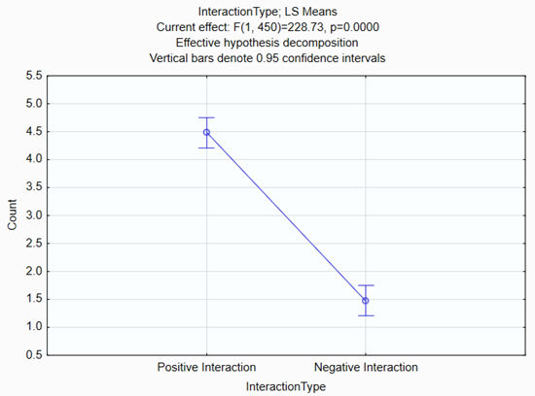
Interaction Type
ANOVA
In average, if a teacher interact with a student 5 times, 4 interactions would be positive and 1 negative.
Significant Difference

Slide 16
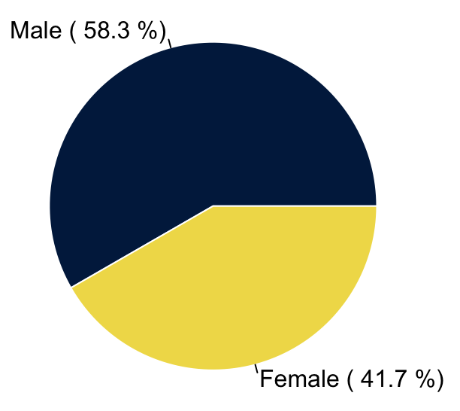
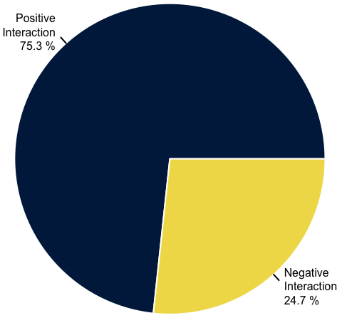
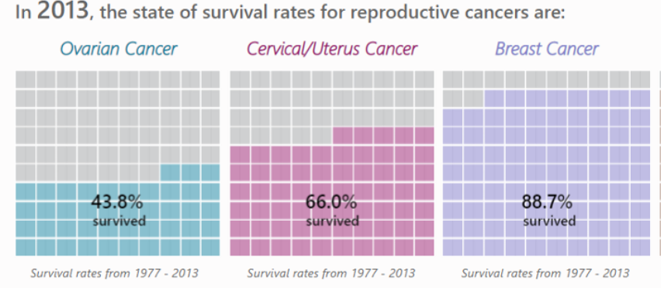
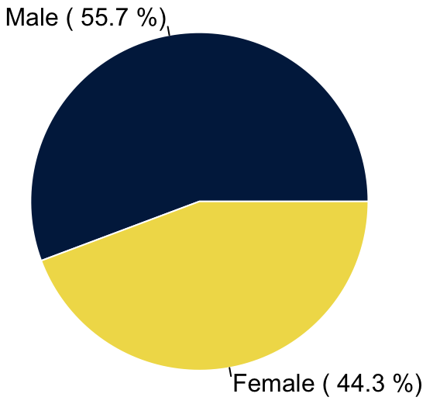

Type of interactions by gender
hypothesis: male students are more likely to have positive interactions than female students.
Distribution of type of interaction for males
Distribution of positive interaction by gender
Distribution of negative interaction by gender
Distribution of type of interaction for females

Slide 17
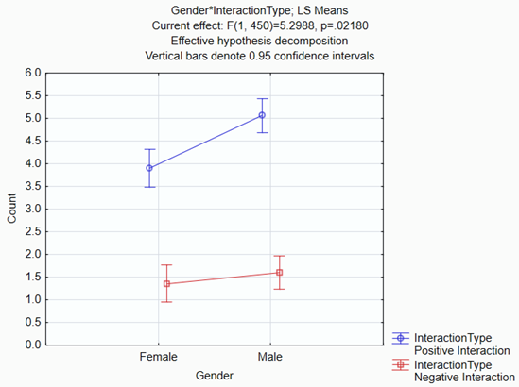
Type of interactions by gender
ANOVA
In average, a man will receive more positive interactions than a woman. But, a woman won't receive more negative interactions than a man.
Significant Difference

Slide 18
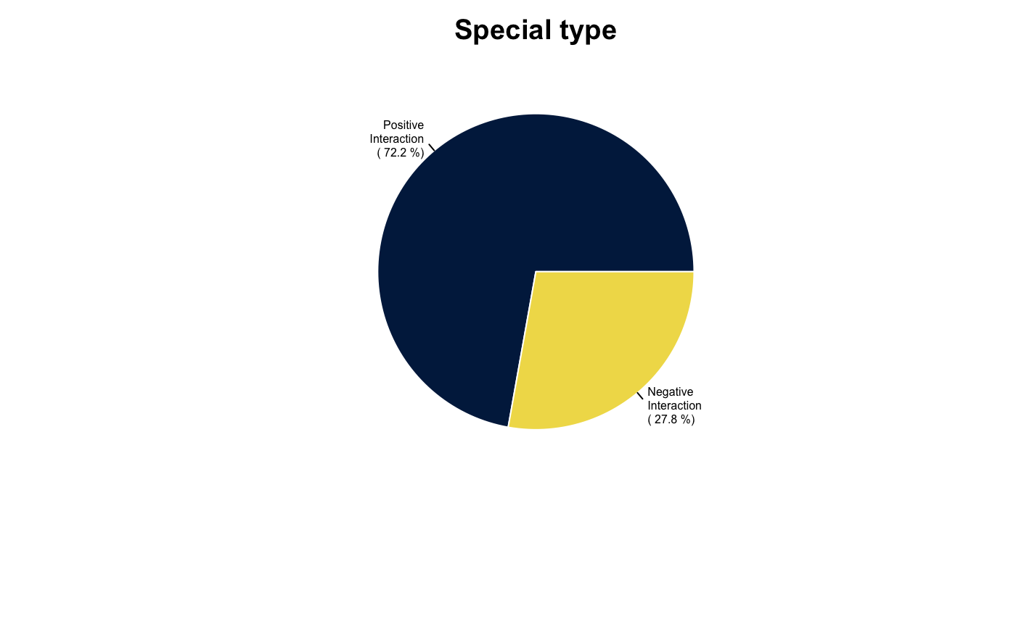

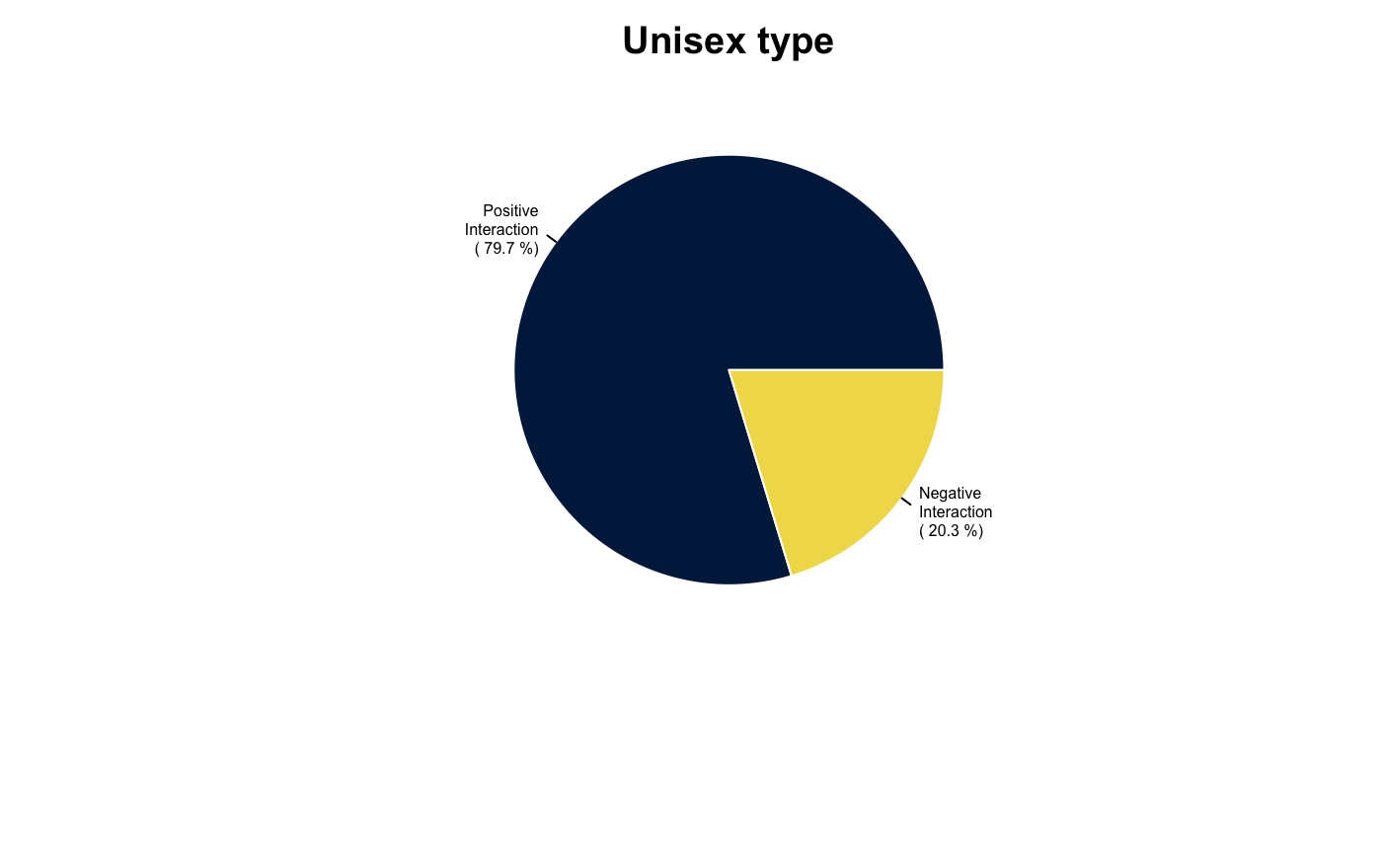
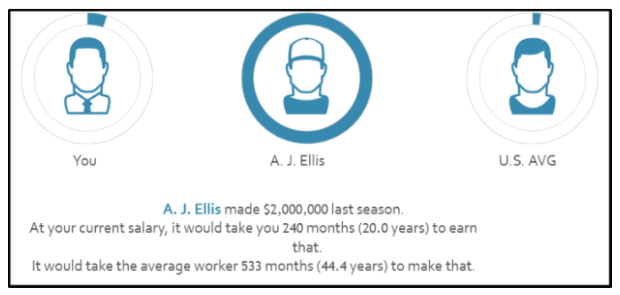
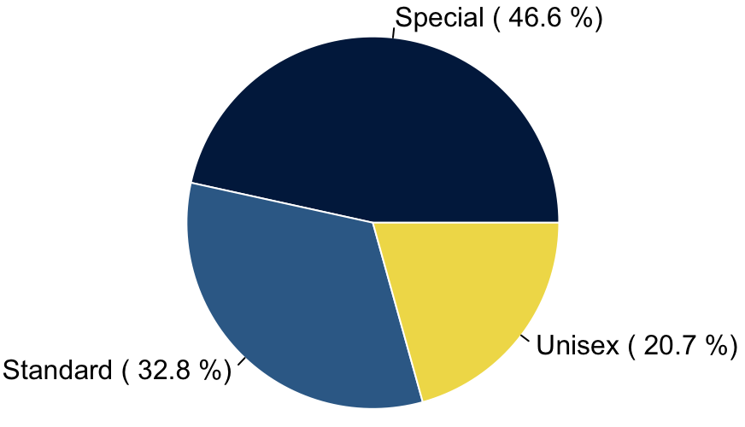
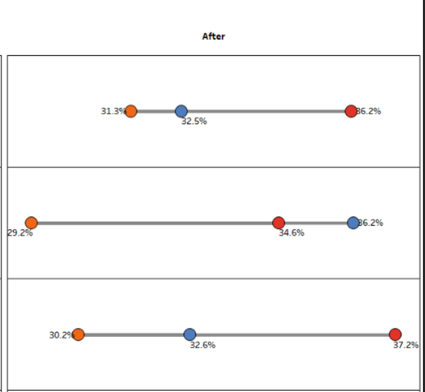
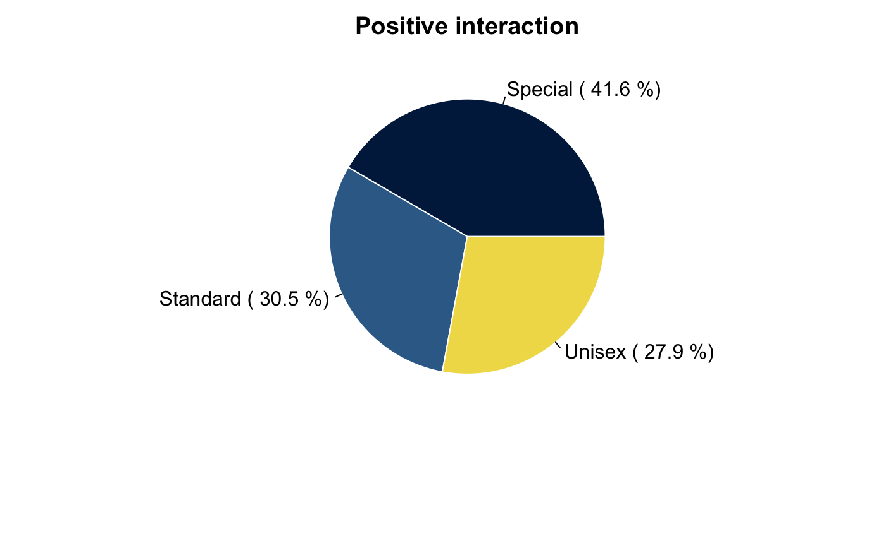
Type of interactions by clothing type
Distribution of clothing type by type of interaction
Distribution of type of interaction by clothing type
Positive int
Special
Standard
Unisex
hypothesis: students with unisex clothing have more chances of having a positive interaction with the teacher, than those with standard clothing.
Negative int

Slide 19
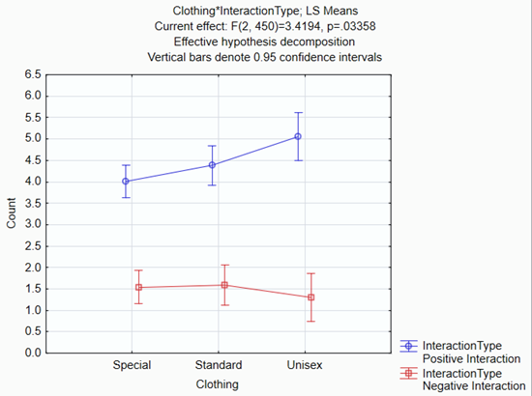

Type of interactions by clothing type
ANOVA
A student with unisex clothes tends to receive more positive interactions ans less negative interactions than the others.
However, the difference is not strong.
Significant Difference

Slide 20
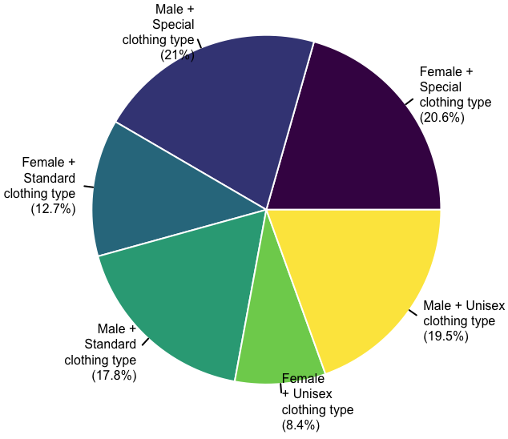
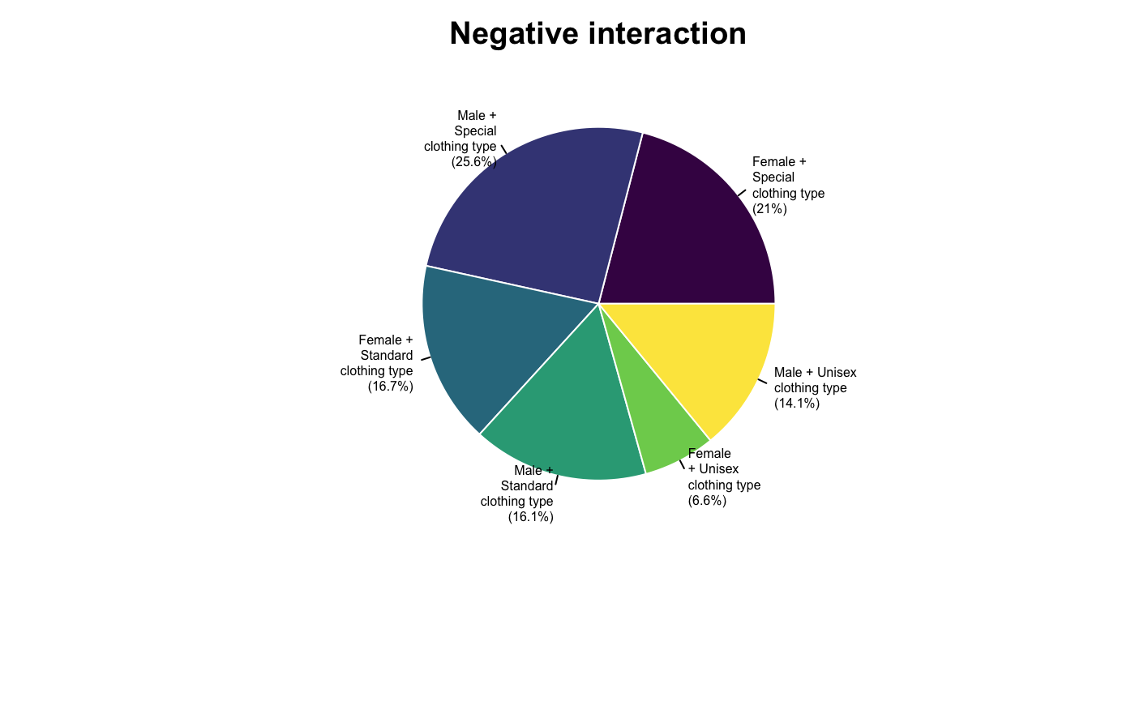
Type of interactions by gender
Heat map

Slide 21
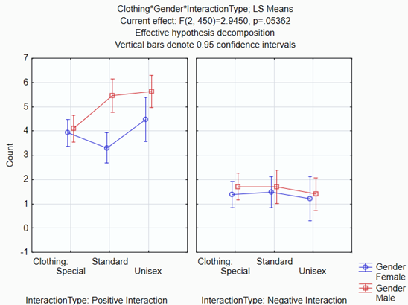
Type of interactions by gender and clothing
There is no difference between gender, clothing, and negative interaction with the teacher. However, it seems that a man with strange clothes tends to have less positive interactions than the other men.
NO Significant Difference

Slide 22
Part 5:
Summary of findings
6. Recommendations
7. Limitations and further improvements

Slide 23
Summary of findings
The teacher don’t interact in the same way with all the students.
In average he/she interacts more with men than with women.
The teacher, interacts more positively with men than with women.
If a male student has strange clothes, he would have less positive interactions than the other men.
The negative interactions are not related with clothing type or gender.
The more a student interacts with the teacher, the more positive the interactions are.

Slide 24
Part 6:
Recommendations
7. Limitations and further improvements

Slide 25
Recommendations
Communicate about the underlying gender bias in student-teacher interactions with the faculty and encourage them to maintain equality in their interactions with the students
Analyse the performance of the students (especially male students with special clothing) in their course, to see if the less number of positive interactions with the teacher affects their learning.

Slide 26
Part 7:
Limitations and further improvements

Slide 27

Limitations and further improvements
Attributes like Interaction type and clothing are subjective. Depend on the person that is collecting the information.
If the information was collected in just one day and just by one person it can be biased. (contrast effect bias)
Perform again the experiment with the same teacher and verify if the results are the same.
When collecting the data is better to know the proportion of positive and negative interaction (with the total number of interactions), or the number of positive and negative interaction per student. That way each row corresponds to a student.

Slide 28
Additional remark
If the institution wants to make institute-wide policies based on this experiment, it is strongly advised that more teachers (of diverse backgrounds) are included in the data-collection, to avoid individual bias. All the results and conclusions of this report is based, and restricted, on the data collected using a single teacher, by the institute.

Slide 29
Thanks!
Any questions?
Find me at @DataSapiens & info@datasapiens.com

